Slide 1

Red Team Ops
A Beginners Guide to Red Team Operations

Slide 2
WHOAMI
Notes: Red Team Notes 2.0
Twitter - @dmcxblue
Red Teamer @ Voya
Certificates
OSCP – Offensive Security Certified Professional
OSWP – Offensive Security Wireless Professional
CRTO – Certified Red Team Operator
CRTA – Certified Red Team Analyst
CRTS – Certified Red Team Specialist

Slide 3
What is a Red Team??
A good dictionary definition is provided by Joe Vest and James Tubberville:
Red Teaming is the process of using tactics, techniques and procedures (TTPs) to emulate a real-world threat, with the goal of measuring the effectiveness of the people, processes and technologies used to defend an environment

Slide 4
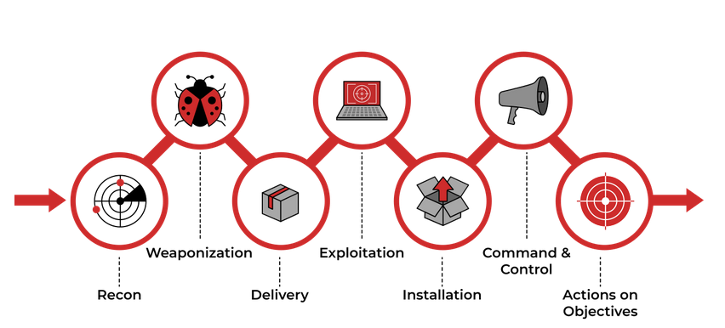
Cyber Kill Chain

Slide 5
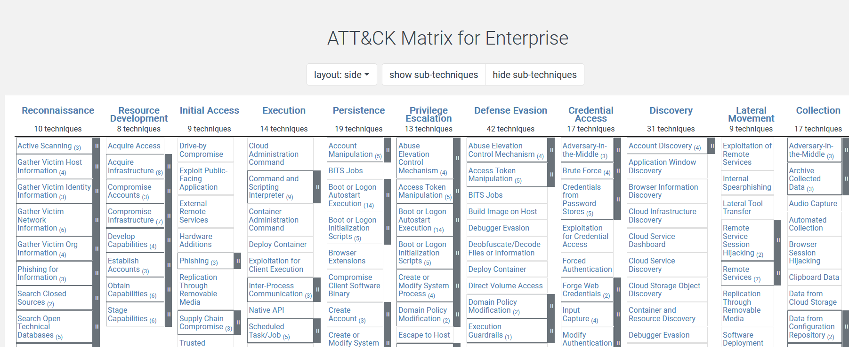
MITRE ATT&CK

Slide 6
Reconnaissance
Passive Reconnaissance
This type of reconnaissance is known as Open-Source Intelligence (OSINT).
Active Reconnaissance
Active reconnaissance is the opposite of passive reconnaissance and the process of gathering information by interacting with the target.
External Reconnaissance
External recon is anything that takes place outside the target’s network.
Internal Reconnaissance
Internal reconnaissance takes place within the target network.

Slide 7
External Enumeration

Slide 8
Passive
OSINT framework
Focused on gathering information from free tools or resources. The intention is to help people find free OSINT resources.
https://osintframework.com/
Inteltechniques
An amazing site where search tools are offered for Open Source Intelligence Gathering
https://inteltechniques.com/

Slide 9
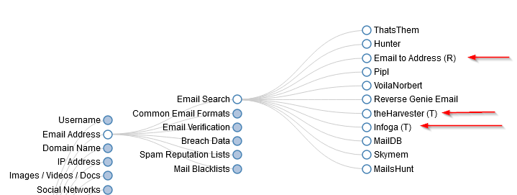
OSINT Framework

Slide 10
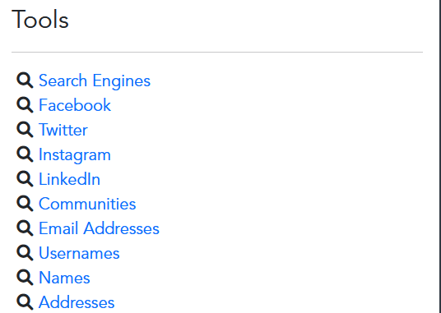
Intel Techniques

Slide 11
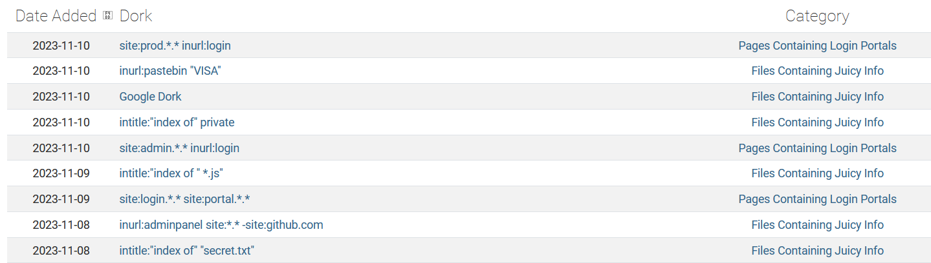
Google Dorking
The GHDB is an index of search queries used to find publicly available information, intended for pentesters and security researchers.

Slide 12
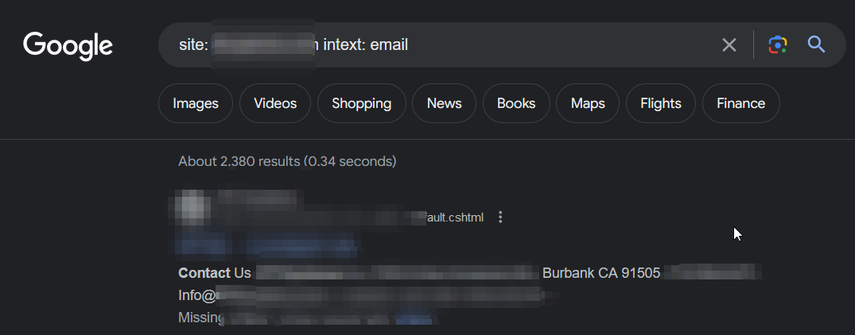
Not 100% accurate since Google tends to fix or hide this type of information when utilizing these queries, but you can still find valuable info

Slide 13
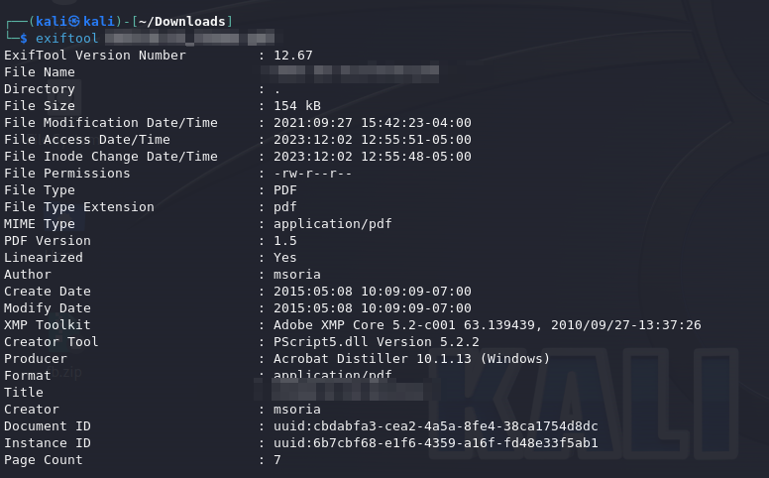
MetaData
“Data that provides information about other data"

Slide 14
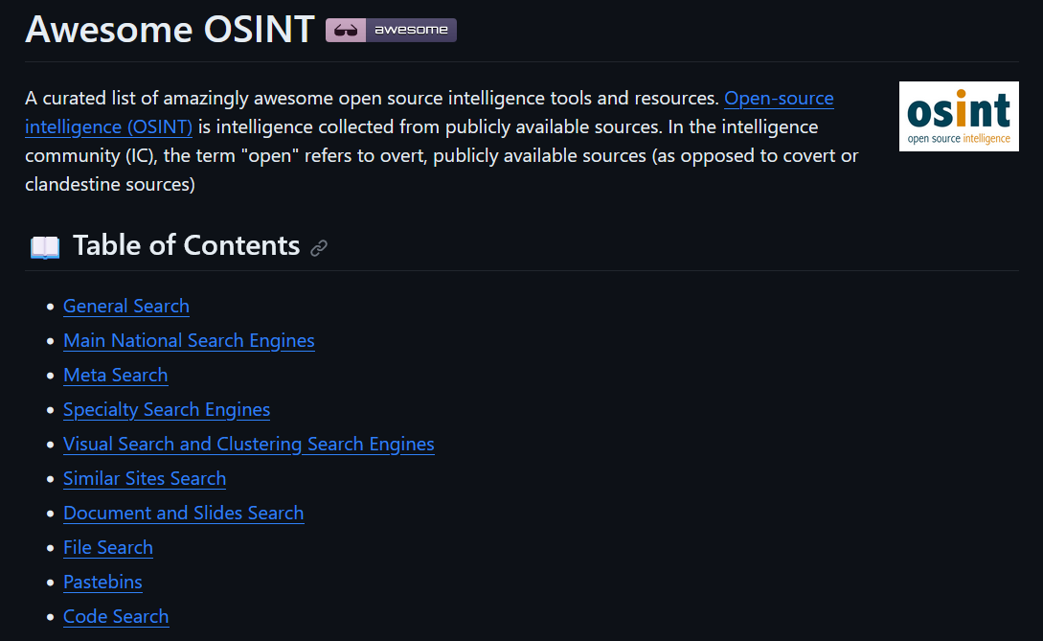
Do not stop there these tools are just the tip of the iceberg, search and explore more as tools with specific or general capabilities are out there.
https://github.com/jivoi/awesome-osint

Slide 15
Active
Nmap
Nmap is a network scanner created by Gordon Lyon. Nmap is used to discover hosts and services on a computer network by sending packets and analyzing the responses.
Nuclei
Nuclei is used to send requests across targets based on a template, leading to zero false positives and providing fast scanning on a large number of hosts. Nuclei offers scanning for a variety of protocols, including TCP, DNS, HTTP, SSL, File, Whois, Websocket, Headless etc.
ETC…

Slide 16
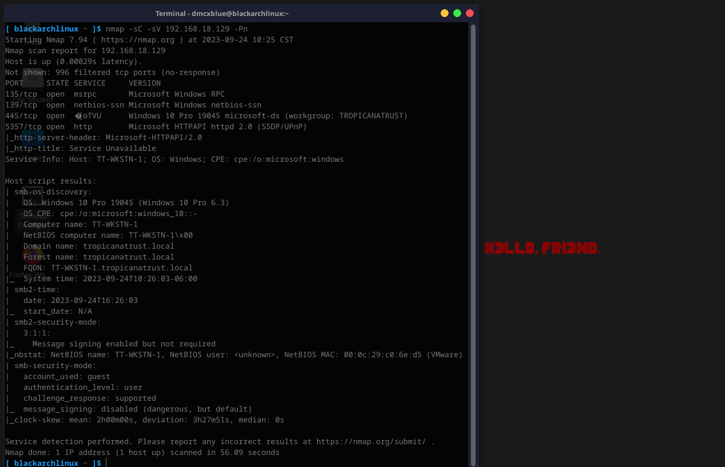
NMAP

Slide 17
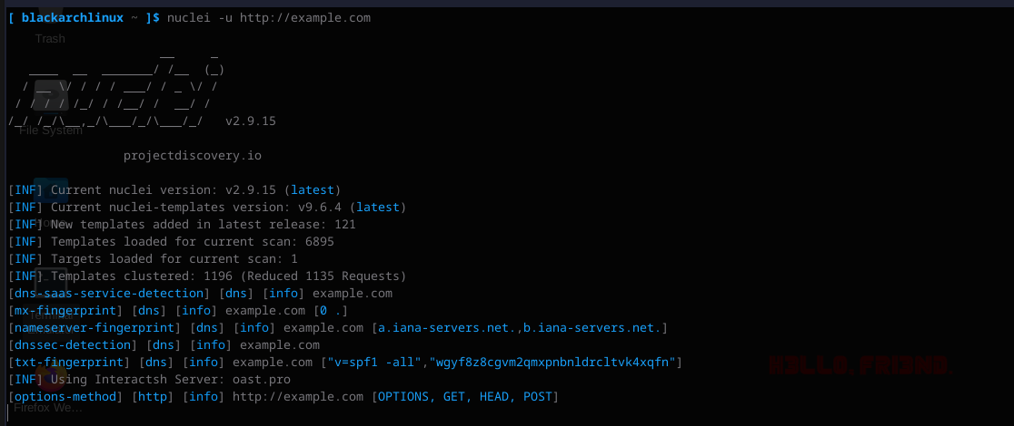
Nuclei

Slide 18
Exercise
Find the location in the photo
Extra: Find secret site with some old posts

Slide 19
Weaponization & Initial Access
Weaponization is the part of the engagement where the Red Teamer generates payloads to exploit the target
Examples:
HTA
MACROS
Jscript
CPL
And More…

Slide 20
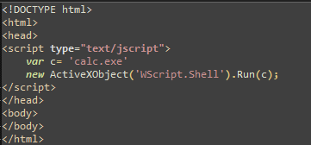
HTA
An HTML Application (HTA) is a Microsoft Windows program whose source consists of HTML, Dynamic HTML, and one or more scripting languages supported by Internet Explorer, such as VBScript or JScript.

Slide 21
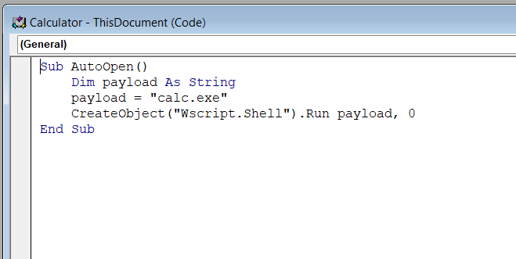
Macros (VBA)
Macros, they are series of commands and instructions that you group together as a single command to accomplish a task automatically. Macros are also popular since these can interact with the Windows API

Slide 22
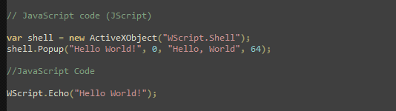
JScript
JScript is a scripting language developed by Microsoft. It is very similar to JavaScript, and in fact, JScript was Microsoft's implementation of JavaScript for their Internet Explorer web browser.

Slide 23
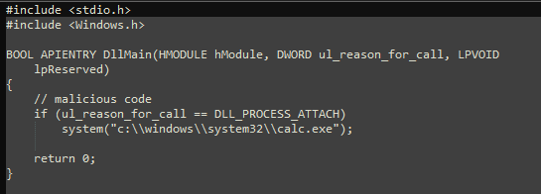
CPL
A CPL file is short for Control Panel File. These files are binary files that open with the control panel in a Microsoft Windows operating system and are used to represent and open the tools available in the control panel.
We can see that the .cpl is simply a DLL with DllMain function exported:

Slide 24
Password Spraying
Password spraying is a type of cyberattack that targets user accounts and online services, typically with the aim of gaining unauthorized access.
Unlike traditional brute-force attacks, where an attacker systematically tries every possible password for a single user account, password spraying involves trying a few commonly used passwords or a list of commonly used passwords across many user accounts.

Slide 25
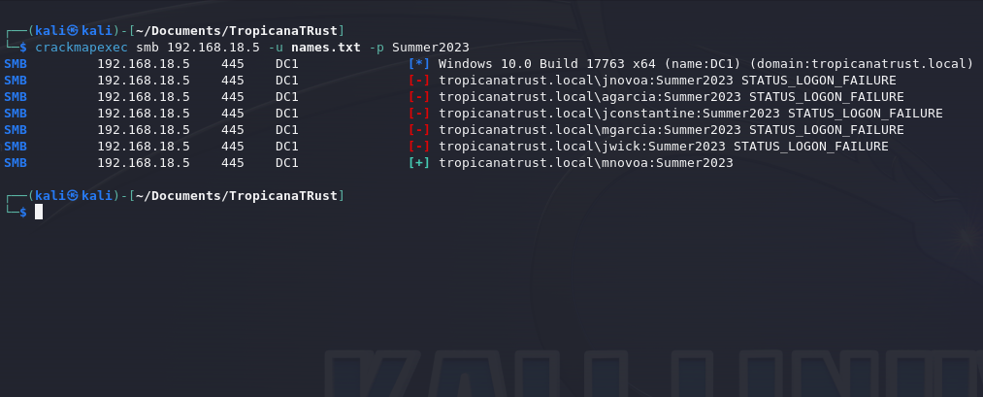

Slide 26
Bonus: AV/EDR
Static Detection
Such as malicious strings (Mimikatz, Meterpreter, Shellcode)
Runtime Detection
When execution happens (What’s the payload doing?, Calling a DNS back?, Calling specific API’s?)
Behavior Detection
What’s the process doing?, Reading Files? Requesting Tickets, Suspicious Commands? (Whoami, Net User, ipconfig)

Slide 27
We will encounter security products, features that are applied to the format itself besides the AV/EDR that we are encountering on the host.
PowerShell: AMSI, Defender
Macros: AMSI, Mark of the Web, Defender
C#: AMSI, Defender
JSCRIPT: AMSI, Defender
As mentioned previously even our actions can activate these rules of blockage because pf behavior monitoring:
Running suspicious commands
Calling suspicious APIs
Disabling/Removing Programs or Services

Slide 28
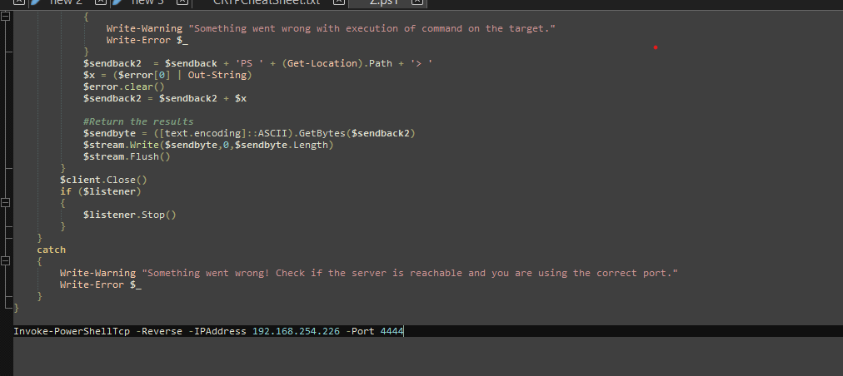

Slide 29
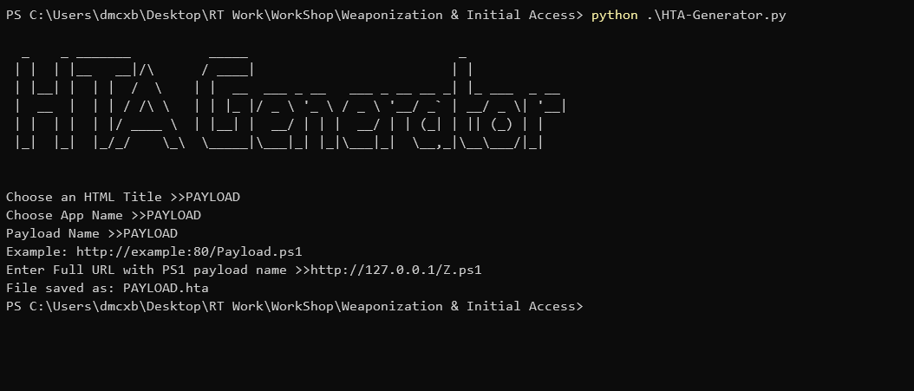

Slide 30
Exercise
Call another process besides calc, can you call something else besides programs in the System32 folder?
Can you call a reverse or bind shell, use anything available custom, open source, private tools
Extra: Bypass AV and gain a Reverse Shell
Utilize the HTA and Macro Generator to help build a stager

Slide 31
Delivery
How are payloads delivered?
Digital, Physical?
What are the types of digital forms of deliveries or services available
Facebook, Google Chat, Zoom, Instagram, Teams, LinkedIn
Phishing, Vishing, SMShing
Emails, Calls, Text Messages

Slide 32
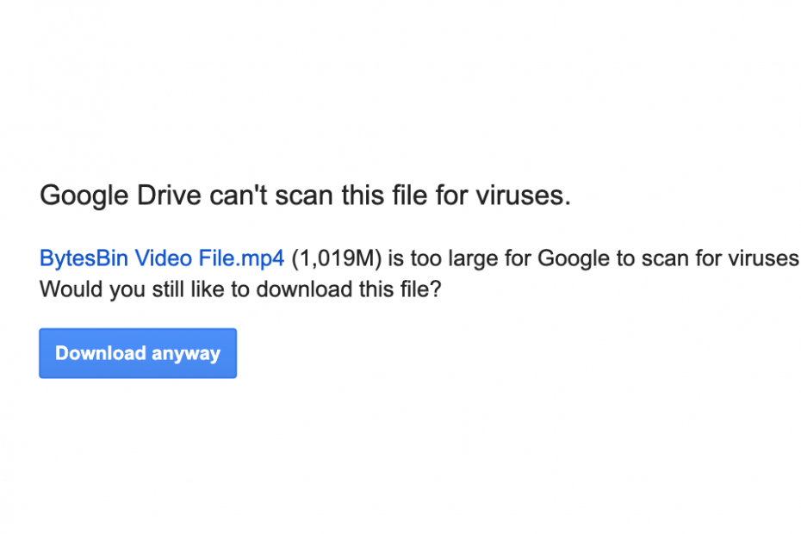
Some services have limitations when scanning files.
They prioritize speed and delivery

Slide 33
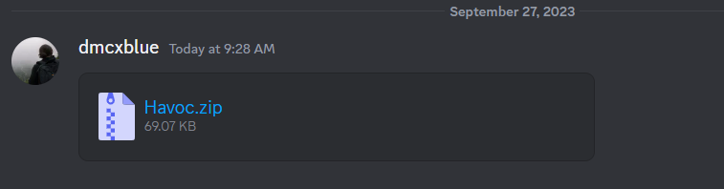
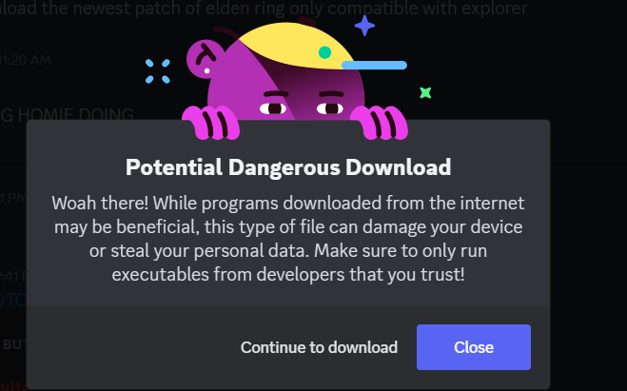
Others allow them
But of course, they come with Warnings

Slide 34
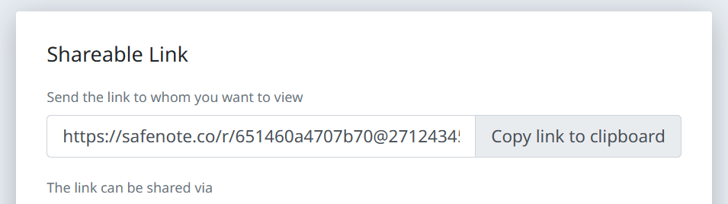
Some sites don’t bother looking at the files

Slide 35
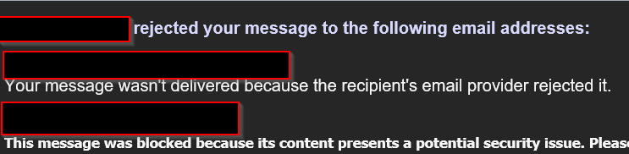
HTML Smuggle
File smuggling is a technique that allows bypassing proxy blocks for certain file types that the user is trying to download. For example, if a corporate proxy blocks .exe files from being downloaded via the browser, this is the technique you can use to smuggle those files through.
https://outflank.nl/blog/2018/08/14/html-smuggling-explained/

Slide 36
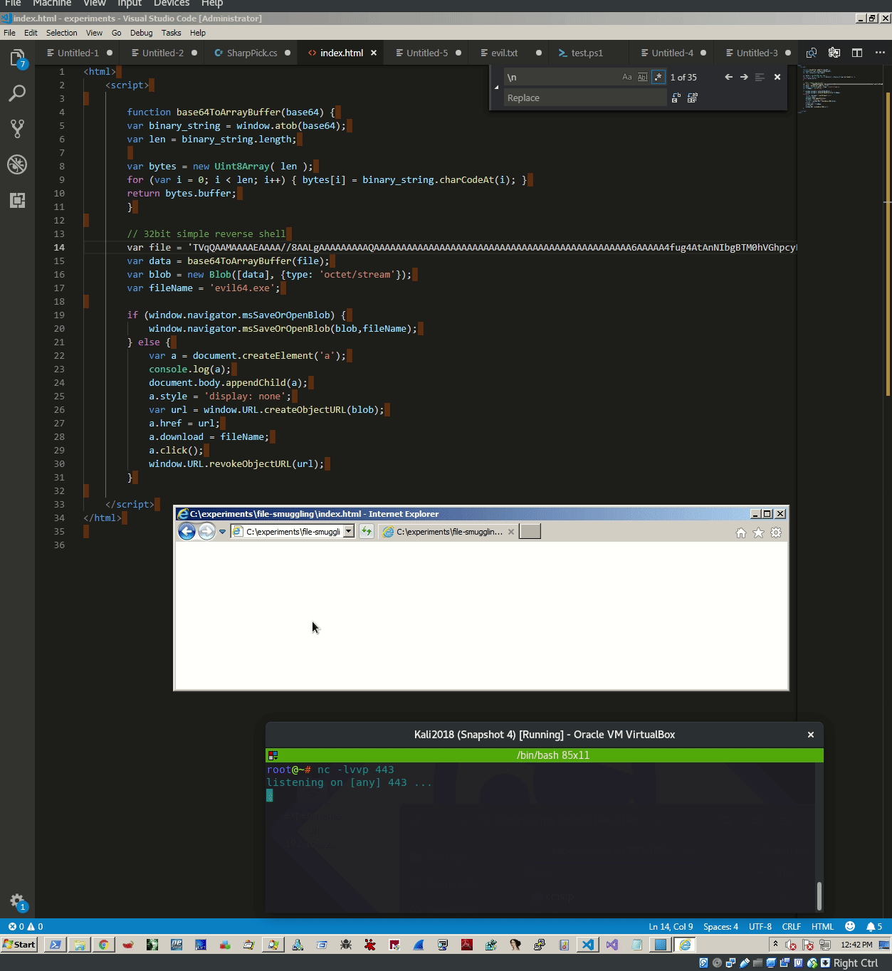

Slide 37
Internal Enumeration

Slide 38
PowerView
PowerView is a PowerShell tool to gain network situational awareness on Windows domains. It contains a set of pure-PowerShell replacements for various windows "net *" commands, which utilize PowerShell AD hooks and underlying Win32 API functions to perform useful Windows domain functionality.
https://powersploit.readthedocs.io/en/latest/Recon/

Slide 39
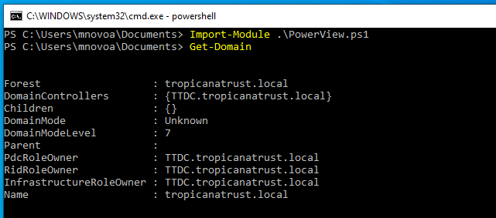
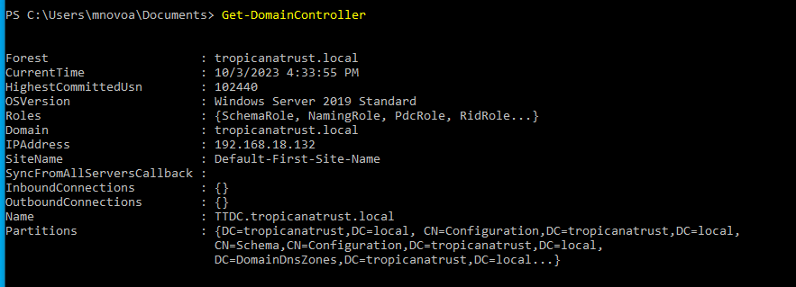
Domain Enumeration
Domain Controller Enumeration

Slide 40
SharpView
SharpView is a .NET Port of PowerView, its functionality is the same but with .NET we have the capability of loading binaries in memory used by C2s, Example: Execute-Assembly, dotnet inline-execution, etc.
As in memory techniques got quite popular and PowerShell started becoming better at Detections and Logging, operators had to move to a different method for executing their PowerShell enumeration tools, you might find a ton of PowerShell tools ported to C# because of this.

Slide 41
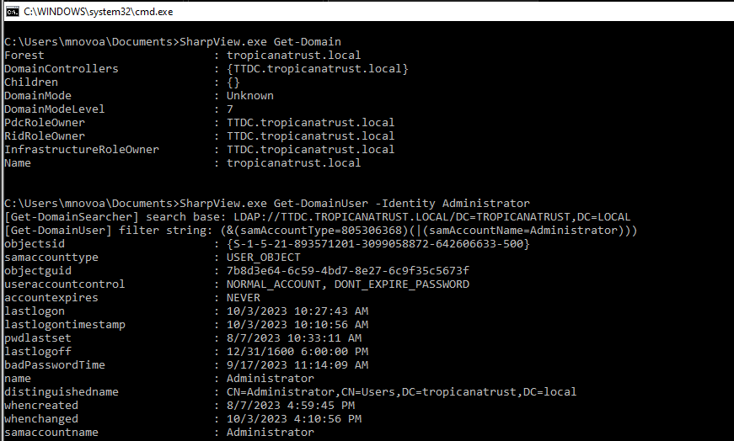
Sharpviews similar output all done using C#

Slide 42
BloodHound
BloodHound uses graph theory to reveal the hidden and often unintended relationships within an Active Directory or Azure environment. Attackers can use BloodHound to easily identify highly complex attack paths that would otherwise be impossible to quickly identify
https://github.com/BloodHoundAD/BloodHound

Slide 43
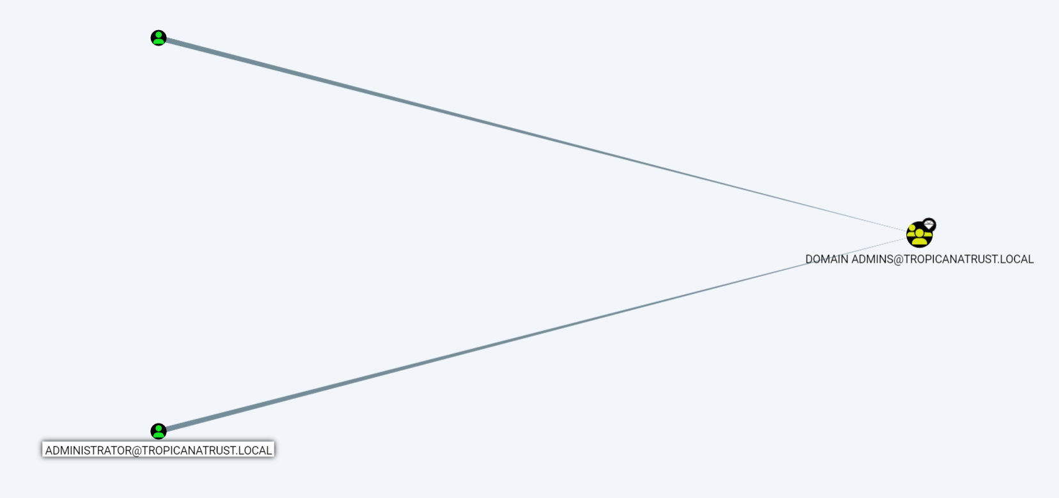

Slide 44
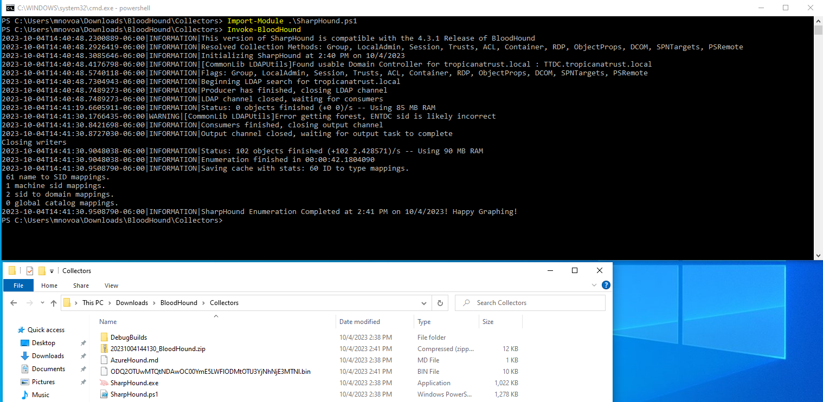

Slide 45
Persistence (User Level)
Persistence consists of techniques that adversaries use to keep access to systems across restarts, changed credentials, and other interruptions that could cut off their access.
These methods are only achievable by user level permissions the operator wouldn't have access to anything that requires administrator privilege.

Slide 46
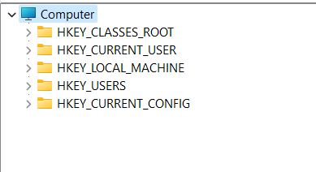
Registry Keys
There are 2 categories of registry key the SYSTEM and USER keys the user has access to edit the user keys and modify as they user would like to but some that are to be mentioned are the Run and RunOnce keys, they are helpful since they would run when a user logs out or restarts the machine.

Slide 47
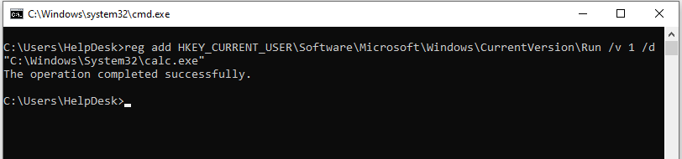
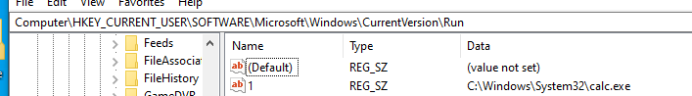
OPSEC: This key will not remove itself once executing!!!

Slide 48
Start Up Folder
The startup up folder is a folder that contains programs that will initiate at boot time once a user has logged onto their session, this is another great method for user persistence as the user has write permissions in their own start up folder.
Anything placed in these folder will execute once a user logs in.

Slide 49
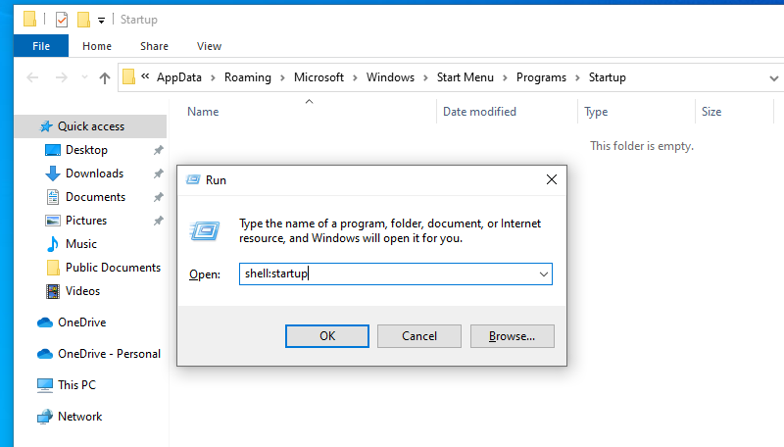
There are 2 locations for startups, the current user folder and the common folder the current user
Will show you the location of the current working users starup folder. The common folder will show you the location
Of the applications that will be ran when ANY user logs in.
shell:staruup
shell:common startup

Slide 50
Exercise
Test your Persistence Techniques:
Look for any OPSEC considerations such as removing your file or maybe leaving a command instead of a binary??
Try as many as you like maybe other persistence techniques from here:
https://github.com/swisskyrepo/PayloadsAllTheThings/blob/master/Methodology%20and%20Resources/Windows%20-%20Persistence.md

Slide 51
Privilege Escalation
The Operator is trying to escalate their privileges on the Network.
Achieving high level privileges is not completely necessary to achieve goals in a Red Team but it is
helpful, we probably need To:
Files, Folder, Locations
Applications
Run tools with high privileges, such as Rubeus to capture tickets and inject
Leave persistence in locations with high permissions (Services, Registry Keys)
Access Credentials (lsass, Browser, Vault)

Slide 52
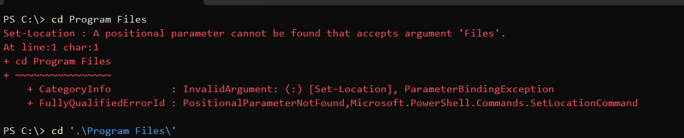
Unquoted Service Paths
A very popular and well-known technique usually some software have very minor but important configurations missing
for example, Quoting (“ ”) a full path of a file or binary, we are aware that Windows has some folders that contain
spaces in them (C:\Program Files\) and these folders or paths without a quote windows sees them as an End Line
where that is a termination of a file name, here is the reason why it's necessary to quote the path so windows sees it as a
complete path when a space(" ") is in the path name.

Slide 53
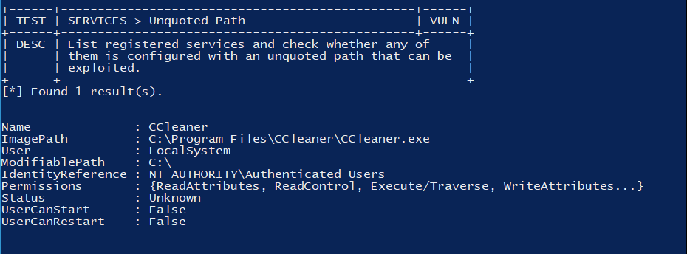

Slide 54
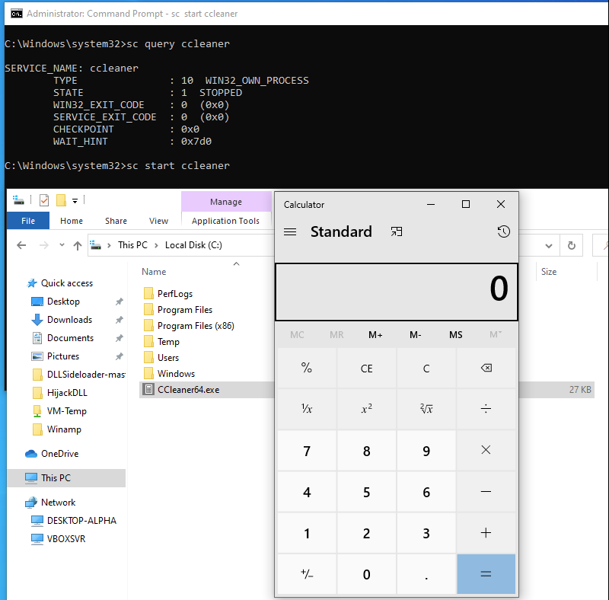

Slide 55
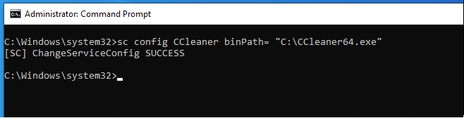
Weak Service Permissions
Adversaries may use flaws in the permissions of Windows services to replace the binary that is executed upon service start.
If the permissions on the file system directory containing a target binary, or permissions on the binary itself are improperly set, then the target binary may be overwritten with another binary using user-level permissions and executed by the original process.
Tools like: Invoke-PrivescCheck and SharpUp can help locate these weak permissions.

Slide 56
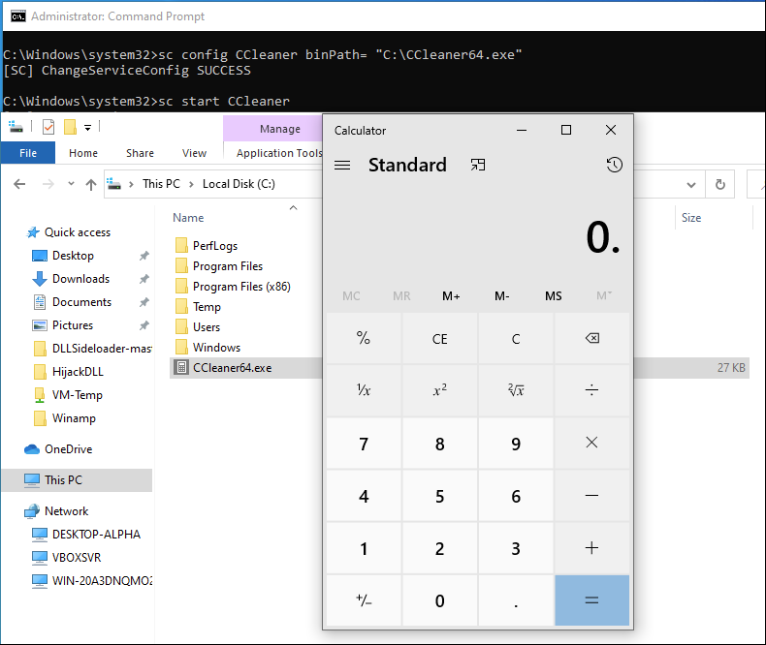

Slide 57
Lateral Movement
Lateral movement is when our Operator will try to jump from one workstation to another, in this section Situational Awareness plays a big role, the operator will need to locate workstations/servers that can help in reaching our goal
OPSEC: Consider understanding the environment, if the network uses certain applications or services to move around. No need for complicated exploits and techniques if we can just blend in with what they are working with (Citrix, TeamViewer, VNC, etc)

Slide 58
WinRM
Windows Remote Management (WinRM) is the name of both a Windows Service and a
protocol that allows a user to interact with a remote system.
The intended audience for Windows Remote Management is IT professionals—who write
scripts to automate the management of servers—and independent software vendor (ISV) developers,
who want to obtain data for management applications.

Slide 59
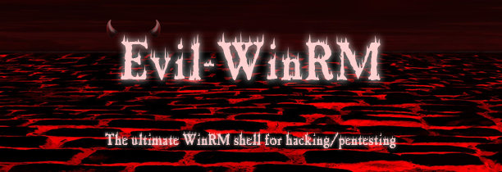
WinRM uses Kerberos for initial authentication by default
Although WinRM listeners can be configured to encrypt all communications using HTTPS, with the use
of Kerberos, even if unencrypted HTTP is used, all communication is still encrypted using
a symmetric 256-bit key after the authentication phase completes

Slide 60
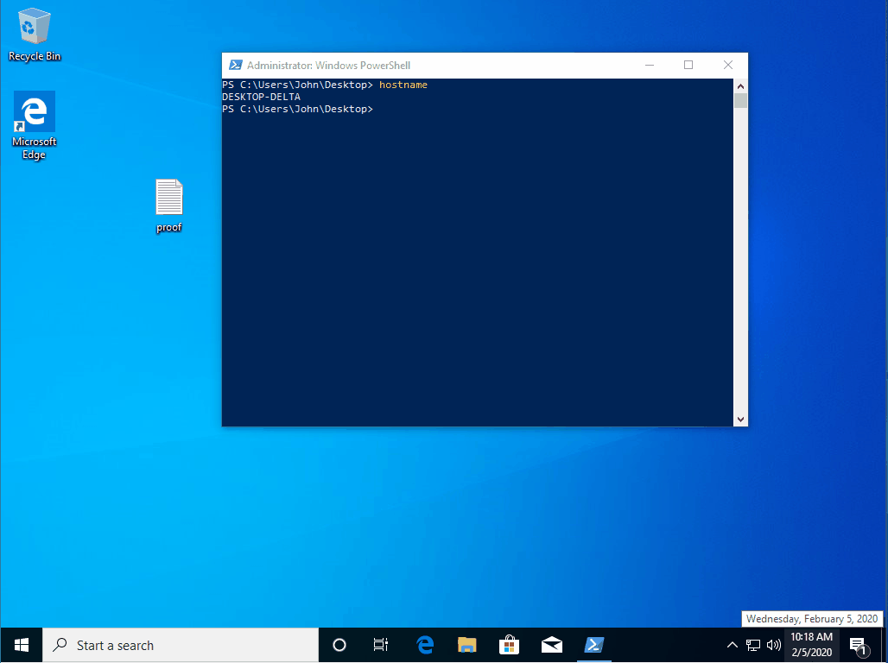
PowerShell

Slide 61
WinRS
WinRS, short for Windows Remote Shell, is a command-line tool in Windows operating systems that allows you to run commands on remote computers.
WinRS relies on Windows Remote Management (WinRM) to establish connections with remote machines. WinRM is a service that enables the execution of remote commands, scripts, and management tasks on Windows-based systems

Slide 62
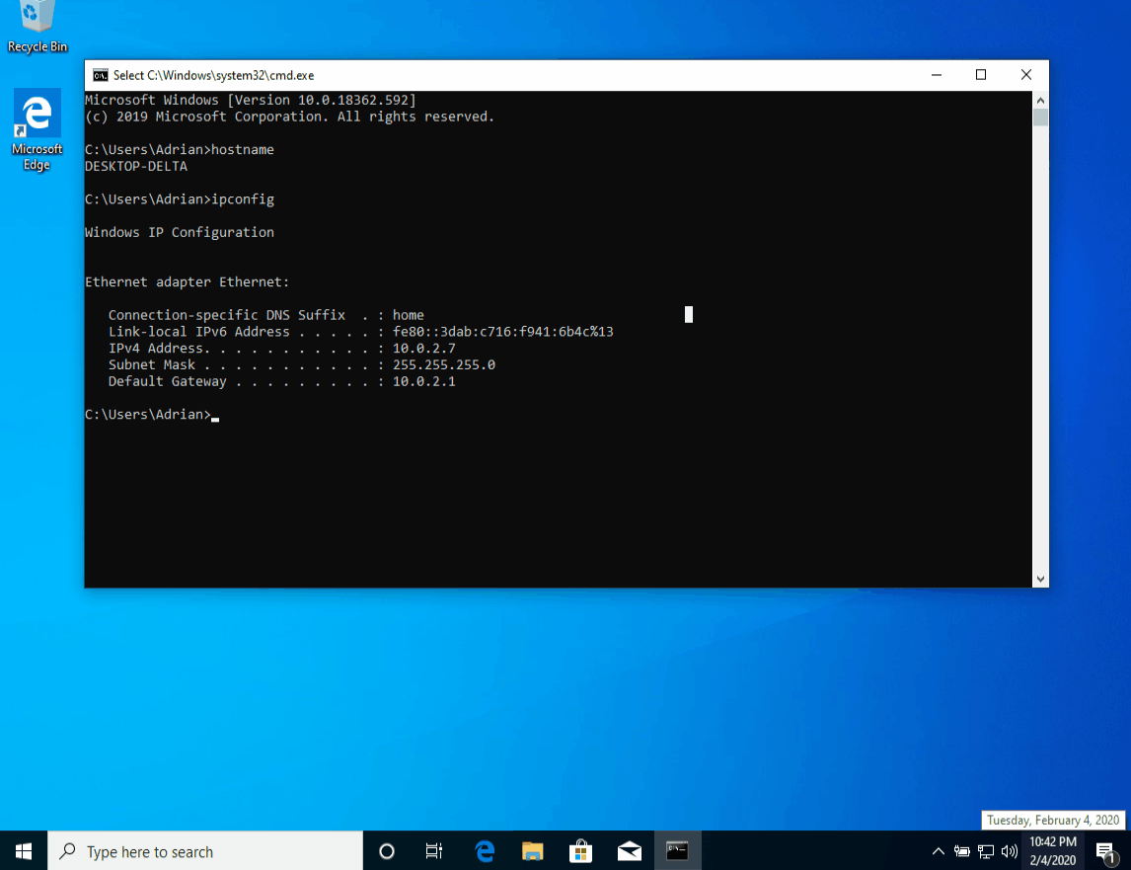
WinRS

Slide 63
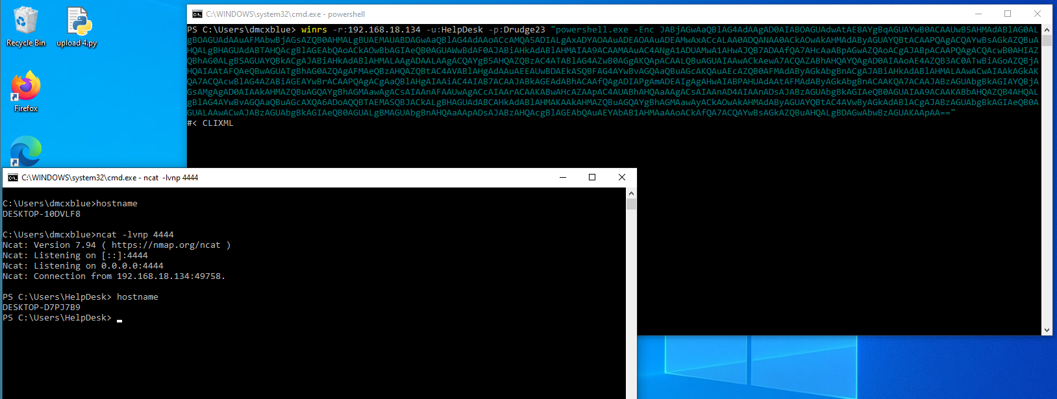
Reverse Shells are possible with this technique, the Demo you can see a simple PowerShell Reverse Shell
being achieved using WinRS but other techniques can be used such as dropping a binary

Slide 64
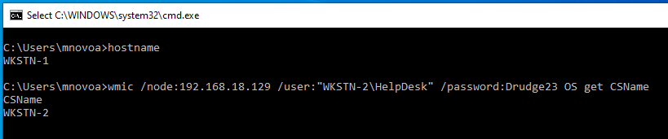
WMIC
WMIC stands for Windows Management Instrumentation Command-line, is a command-line tool in Microsoft Windows it provides a unified interface for Windows management tasks. It allows you to access system resources and settings on a local or remote computer and retrieve information or perform various management tasks.

Slide 65
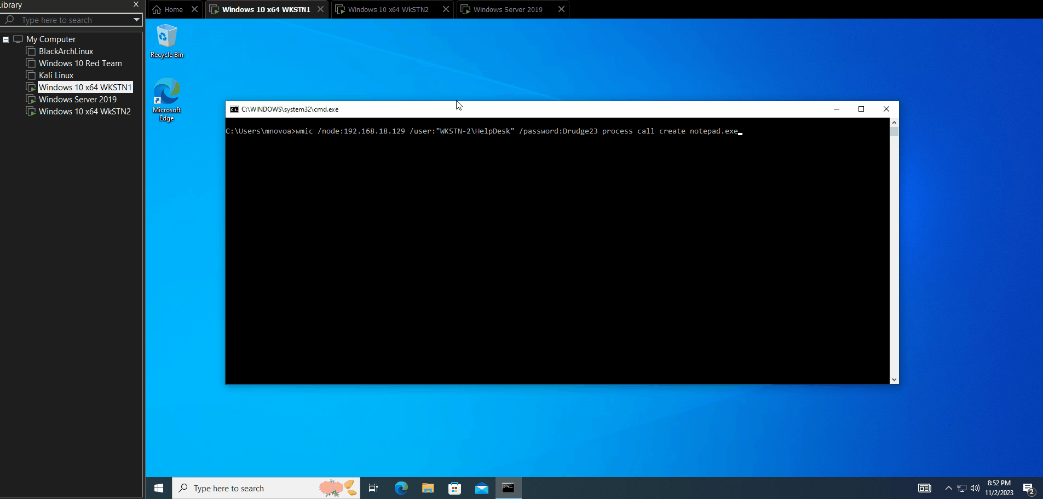

Slide 66
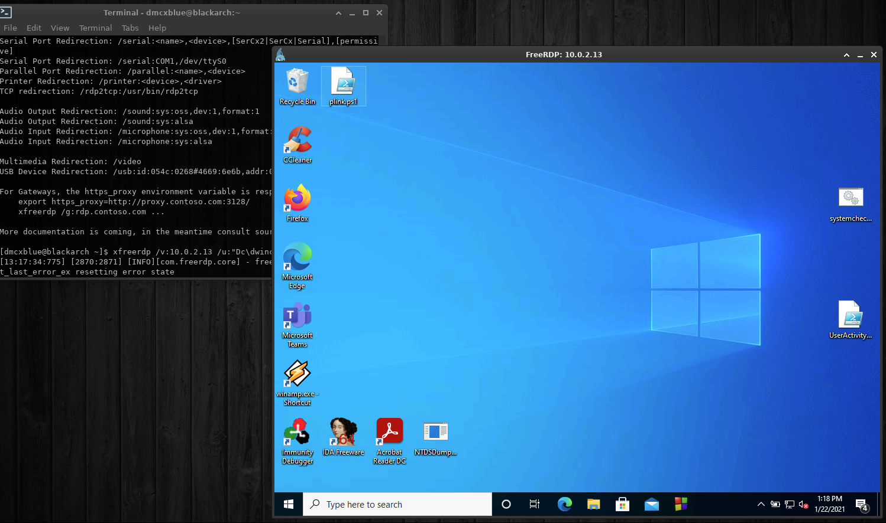
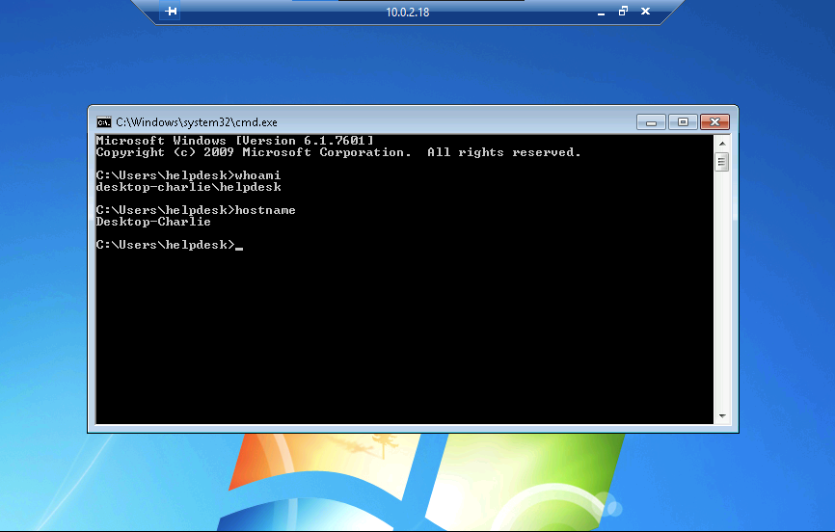
RDP

Slide 67
C2s
C2s or Command and Control Frameworks, in a nutshell it’s framework that holds our beacons or sessions which allows us to interact with them to work with our simulated attacks to mimic the tactics of an APT (Advanced Persistent Threat), while adding features such an Example using BOFs.
Here I’ll scratch the surface of Cobalt Strike

Slide 68
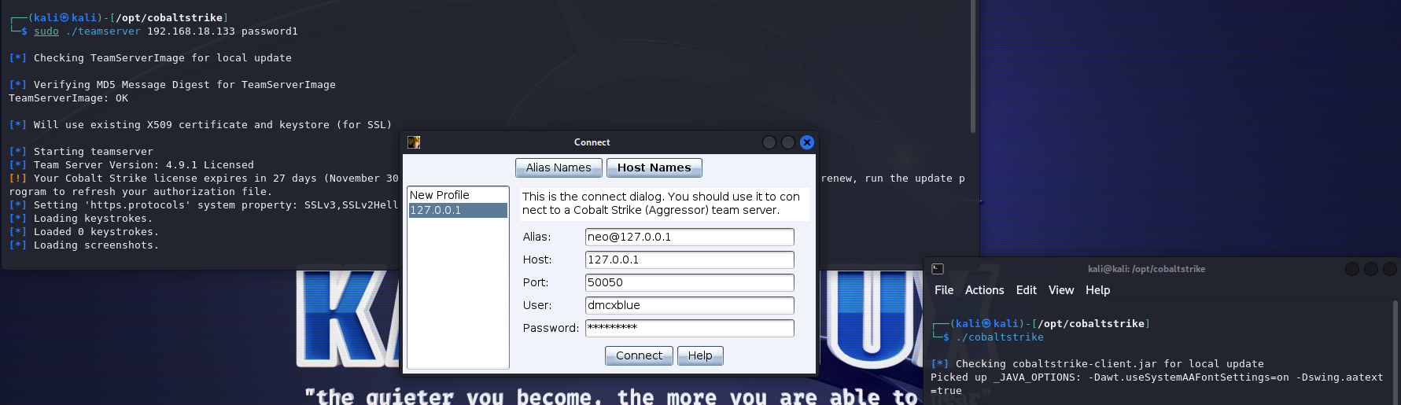

Slide 69
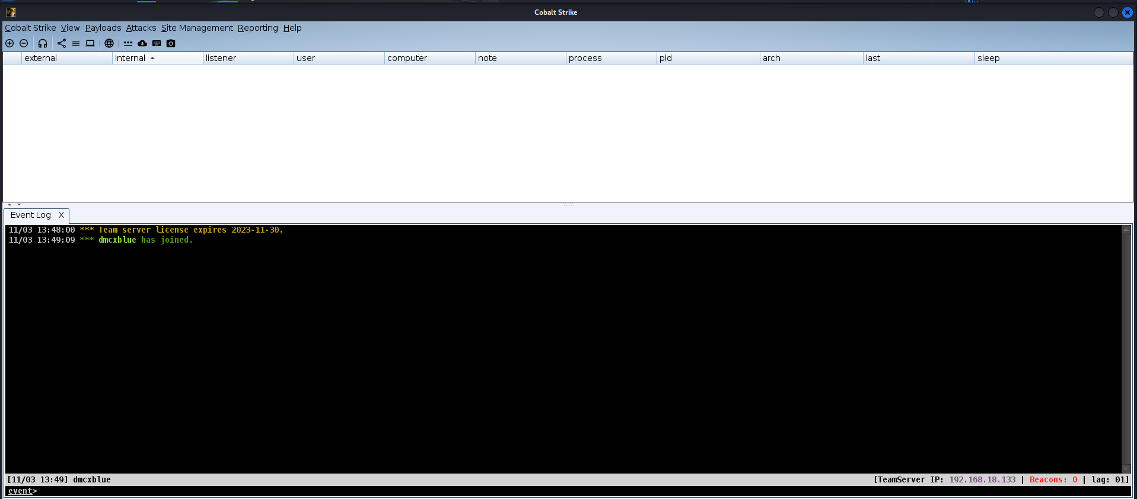

Slide 70
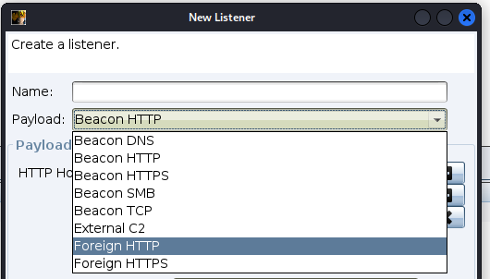
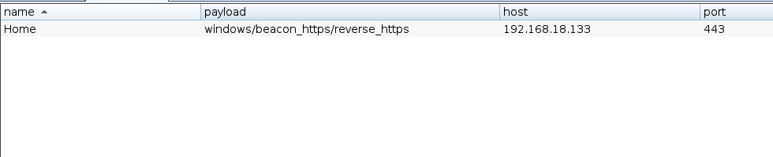
Listeners

Slide 71
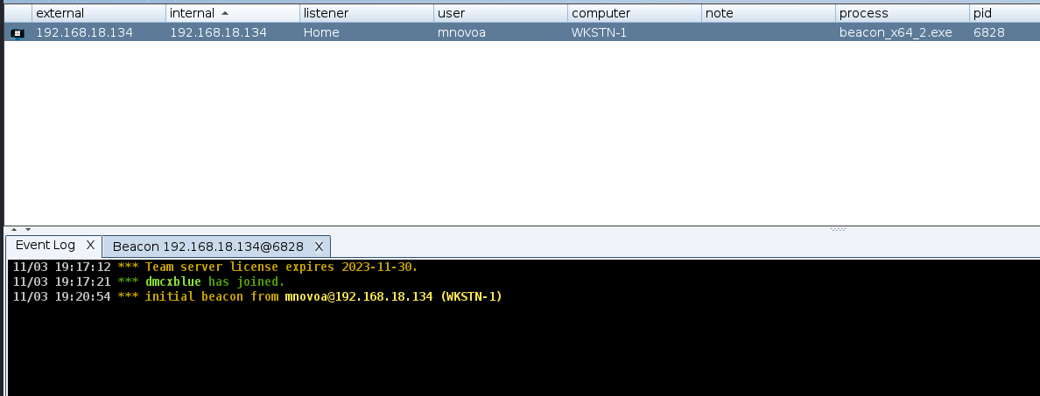
Beacons
Beacon is Cobalt Strike’s signature payload, designed to model the behavior of advanced attackers to perform a number of post-exploitation activities during adversary simulations and red team engagements.

Slide 72



Slide 73



Lateral Movement in CS
Jump Command
Remote-Exec

Slide 74


Internal Movement
By using the LINK command, it will allow you to connect
on remote SMB Pipes we can tell in the graph view
what sessions have established linked connections

Slide 75


Privilege Escalation in CS
Successful Elevation you will notice an Icon of a PC surrounded by Lightning

Slide 76


Aggressors, BOFs
Aggressor Script is the scripting language built into Cobalt Strike, version 3.0, and later.
Aggressor Script allows you to modify and extend the Cobalt Strike client.
A Beacon Object File (BOF) is a compiled C program, written to a convention that allows it to
execute within a Beacon process and use internal Beacon APIs. BOFs are a way to rapidly extend the Beacon agent
with new post-exploitation features.

Slide 77


Slide 78

Community Kit

Slide 79
Q&A

